Slide 1
CCDP10003 Presentation
Evolution in Video Games
Michael Le

Slide 2
Earliest Video Game Produced
Involves a singular line you able to change sound by alternating Amp. TBH I had no clue what this is?

Slide 3
This is produced from a physicist named

Slide 4
First the Atari….

Slide 5
Atari game out

Slide 6
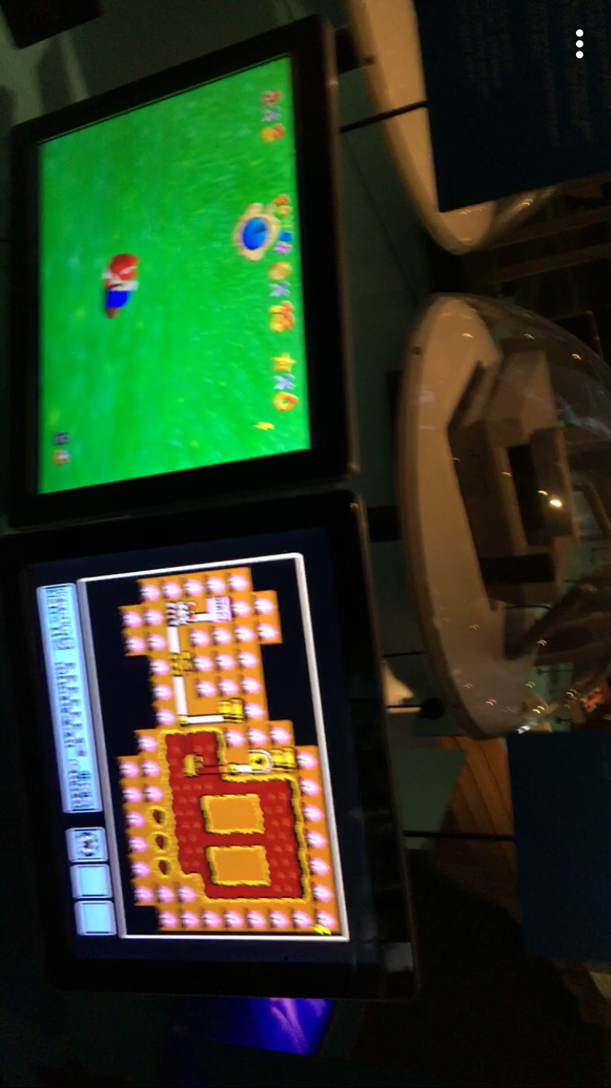
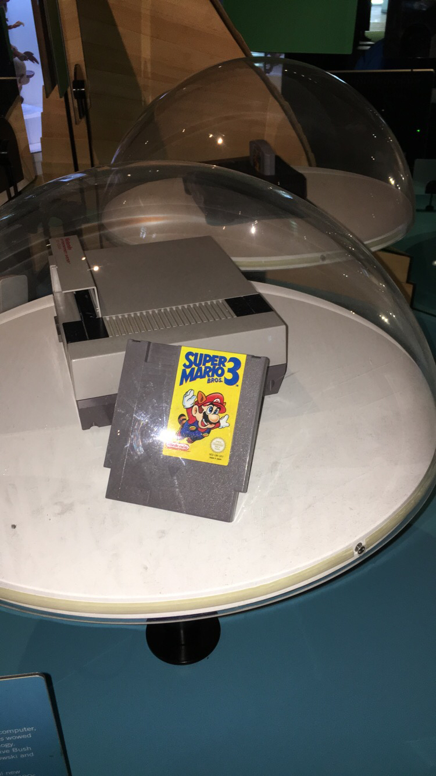
Then NES (Nintendo Entertainment System)
Pictures that were taken during ACMI week

Slide 7
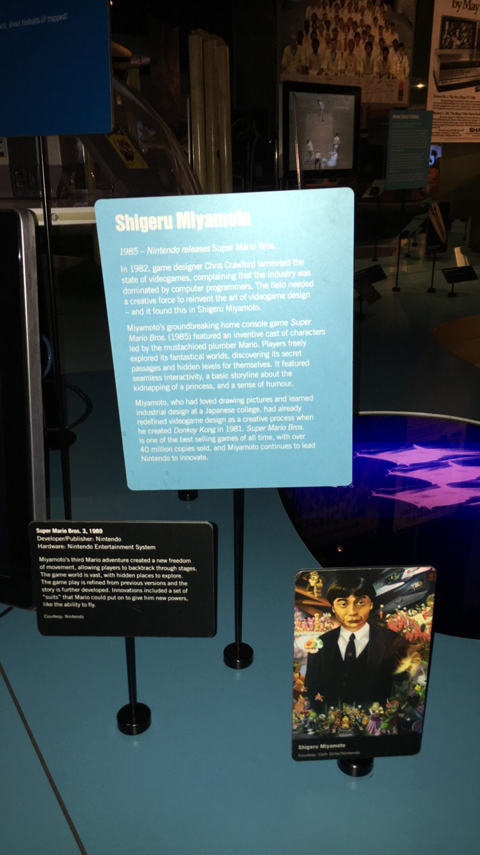

Slide 8
Consoles Expanded!!!

Slide 9
Neuroscience in Video Games

Slide 10
Me playing the game for the first time
First death in a game
After playing the game you died several times, the game tells you have no purpose in a video game. That you don’t give a fuck!!

Slide 11
My Favourite (well recent) games!!

Slide 12
END!!

Slide 13
References
https://www.aps.org/publications/apsnews/200810/physicshistory.cfm
https://www.ncbi.nlm.nih.gov/books/NBK274562/
http://www.gamedonia.com/blog/game-development-quotes-cool-inspiring
https://www.bnl.gov/about/history/firstvideo.php

